Slide 1
How Manure Storage Impacts Farm Emissions

Slide 2
OBJECTIVES
Introduction to the emissions that come from manure
Build awareness and understanding of some key manure emission mitigation options
Debunk manure related myths
There are many opportunities for GHG emissions reductions in manure management systems.

Slide 3
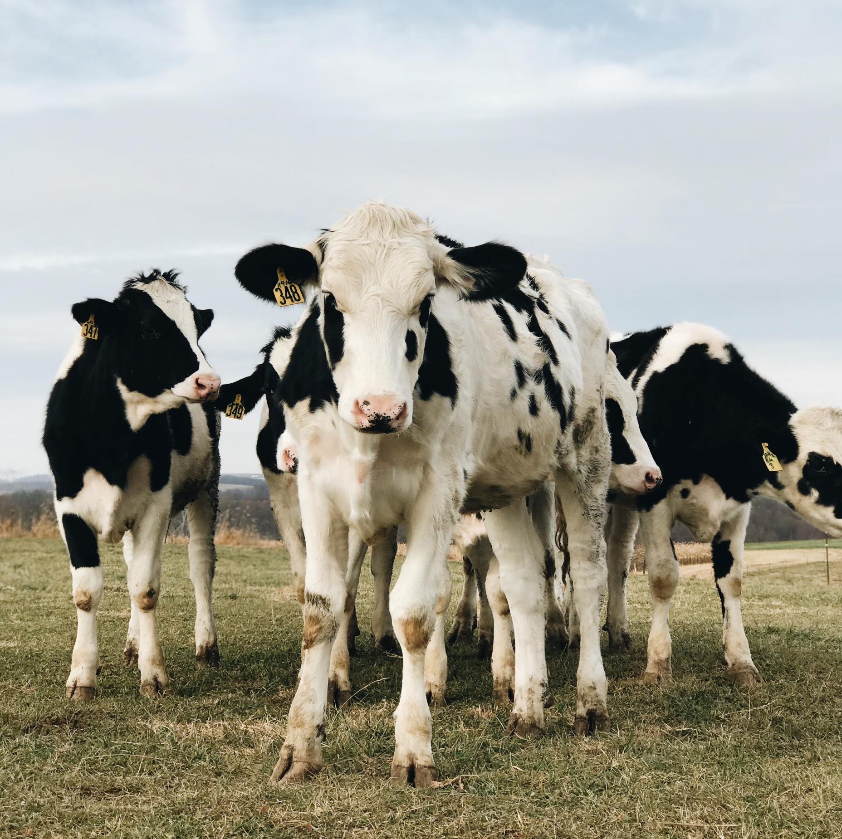
AGENDA
Basics of Manure Emissions
Options to Reduce Manure Emissions
Debunking Manure Myths
Conclusion

Slide 4
Basics of Manure Emissions

Slide 5
MANURE EMISSIONS
Manure is often stored on dairy farms to recycle nutrients for crop production
Storage of manure generates greenhouse gases (GHGs)
Some factors that change the amount of emissions generated during storage:
Temperature
Time in storage
Moisture content
Composition of the manure

Slide 6
GASES OF MANURE EMISSIONS
Methane (CH₄)
Ammonia (NH₃)
Nitrous Oxide (NO₂)
Produced by bacteria breaking down manure in the absence of oxygen
Not a greenhouse gas, generated from the nitrogen in manure and urine
Produced from ammonium through microbial processes of nitrification (ammonium to nitrate) and de-nitrification (nitrate to nitrous oxide)

Slide 7
Options to Reduce Manure Emissions

Slide 8
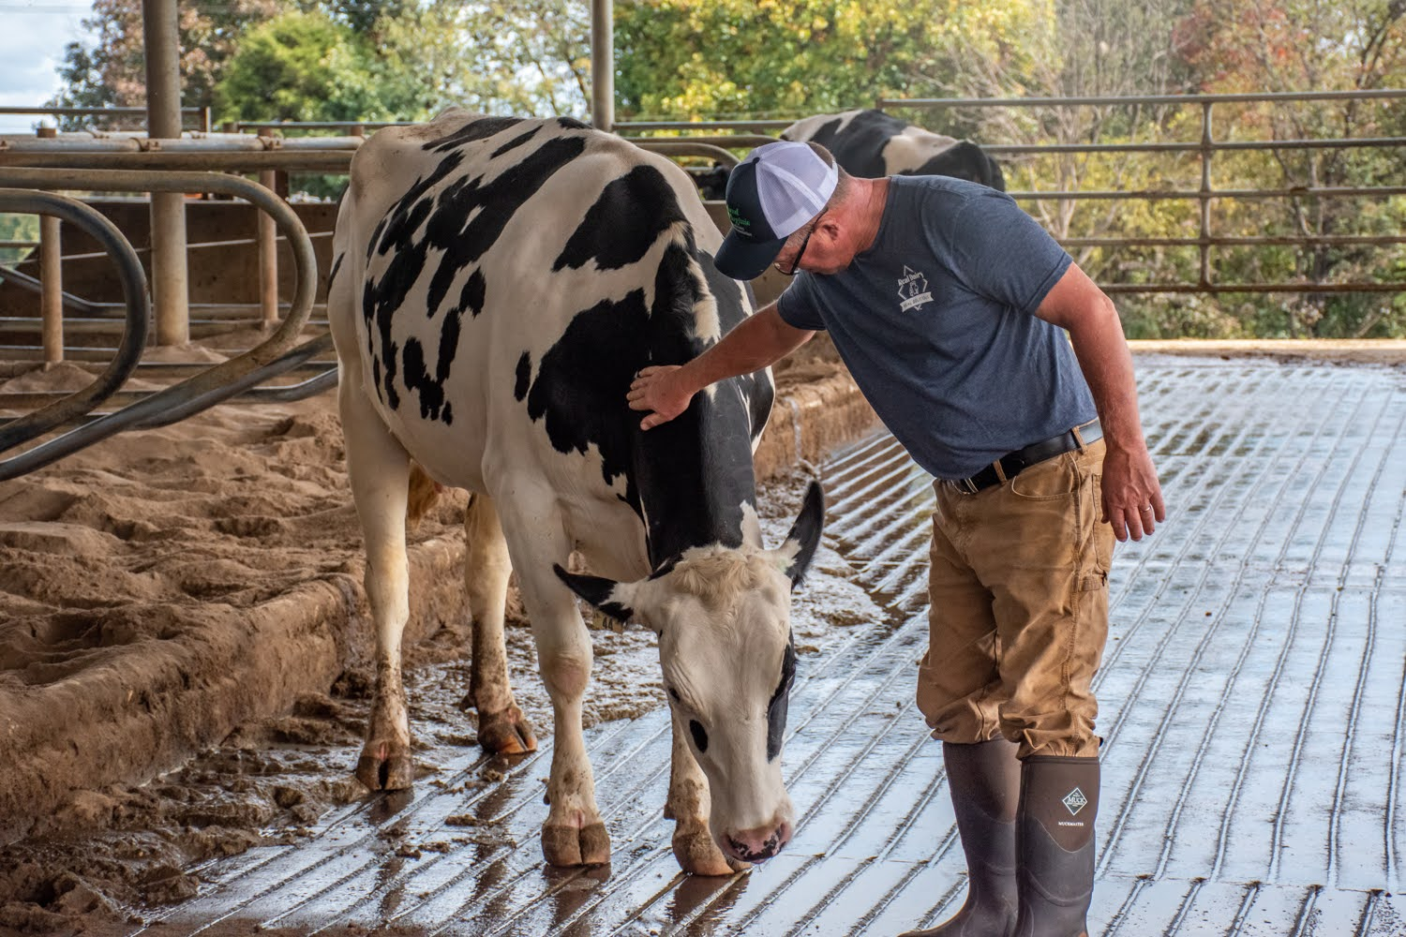
NOT ONE SIZE FITS ALL
Manure handling is just one part of a dairy farm
Emissions come from many different sources within the farm system
There is no one size fits all when it comes to reducing emissions from manure, need to consider the housing type, farm goals, and emissions sources

Slide 9
BIOGAS COLLECTION AND UTILIZATION
Anaerobic Digestion
Microorganisms break down biodegradable material in the absence of oxygen
Anaerobic digestion creates biogas, a combination of methane, carbon dioxide, water vapor, and other gasses
Biogas can be combusted, used for electricity and heat, or even transformed into a natural gas replacement
United States Environmental Protection Agency [EPA] 2024. AgSTAR: Practices to Reduce Methane Emissions from Livestock Manure Management. https://www.epa.gov/agstar/practices-reduce-methane-emissions-livestock-manure-management
Leytem, A.B., S. Archibeque, N.A. Cole, S. Gunter, A. Hristov, K. Johnson, E. Kebreab, R. Kohn, W. Liao, C. Toureene, and J. Tricarico. 2024. Quantifying greenhouse gas fluxes in agriculture and forestry: Methods for entity-scale inventory. Chapter 4: Quantifying greenhouse gas sources and sinks in animal production systems. https://www.usda.gov/oce/entity-scale-ghg-methods/download

Slide 10
BIOGAS COLLECTION AND UTILIZATION
Gas Capture and Flare
Covering manure storage with an impermeable cover, like plastic, allows for the capture of the gases produced
We can then combust the captured methane to convert it into carbon dioxide, a less detrimental greenhouse gas
Ammonia is still an air quality and emissions concern
Methane is more than 28 times as potent as carbon dioxide at trapping heat in the atmosphere (EPA, 2023).
United States Environmental Protection Agency [EPA] 2023. Global Methane Initiative: The Importance of Methane. https://www.epa.gov/gmi/importance-methane,
United States Environmental Protection Agency [EPA] 2024. AgSTAR: Practices to Reduce Methane Emissions from Livestock Manure Management. https://www.epa.gov/agstar/practices-reduce-methane-emissions-livestock-manure-management

Slide 11
MANURE STORAGE & MANAGEMENT
Acidification
Acidification refers to reducing the pH of manure by adding acid or other acidifying agents
Lowering pH can inhibit the activity of methanogens that produce methane
If the pH is low enough, ammonia emissions can be also be reduced
Sulfate can also help to control emissions
United States Environmental Protection Agency [EPA] 2024. AgSTAR: Practices to Reduce Methane Emissions from Livestock Manure Management. https://www.epa.gov/agstar/practices-reduce-methane-emissions-livestock-manure-management
Petersen, S., Andersen, A. and Eriksen, J. Effects of cattle slurry acidification on ammonia and methane evolution during storage. 2012. Journal of Environmental Quality 41:88–94. https://doi.org/10.2134/jeq2011.0184

Slide 12
SOLID LIQUID SEPARATION
Separating manure into liquid and solid portions can reduce the methane emission potential of liquid manure in storage, though some methods can instead enhance emissions. Separated solid matter can also be utilized in different ways (e.g., composting, recycled bedding, land-application) or stored.
Gravity Systems
Separate waste with gravity (e.g., settling basin)
Can enhance GHG emissions depending on storage
Mechanical Systems
Separate waste using machines (e.g., centrifugation)
Can reduce GHG emissions
Chemical Systems
These combine chemical methods like flocculation with mechanical systems
Can reduce GHG emissions
The time that manure stays in the separation system may affect the overall reductions in methane.
United States Environmental Protection Agency [EPA] 2024. AgSTAR: Practices to Reduce Methane Emissions from Livestock Manure Management. https://www.epa.gov/agstar/practices-reduce-methane-emissions-livestock-manure-management
Leytem, A.B., S. Archibeque, N.A. Cole, S. Gunter, A. Hristov, K. Johnson, E. Kebreab, R. Kohn, W. Liao, C. Toureene, and J. Tricarico. 2024. Quantifying greenhouse gas fluxes in agriculture and forestry: Methods for entity-scale inventory. Chapter 4: Quantifying greenhouse gas sources and sinks in animal production systems. https://www.usda.gov/oce/entity-scale-ghg-methods/download

Slide 13
ADVANCED TREATMENT
Evaporation
Evaporation can be used to dry solids enough so that minimal or no microbial activity occurs while in (dry) storage
However, evaporating moisture takes energy!
Incorporating systems that serve as a heat source is ideal for reducing the amount of energy required
United States Environmental Protection Agency [EPA] 2024. AgSTAR: Practices to Reduce Methane Emissions from Livestock Manure Management. https://www.epa.gov/agstar/practices-reduce-methane-emissions-livestock-manure-management
Leytem, A.B., S. Archibeque, N.A. Cole, S. Gunter, A. Hristov, K. Johnson, E. Kebreab, R. Kohn, W. Liao, C. Toureene, and J. Tricarico. 2024. Quantifying greenhouse gas fluxes in agriculture and forestry: Methods for entity-scale inventory. Chapter 4: Quantifying greenhouse gas sources and sinks in animal production systems. https://www.usda.gov/oce/entity-scale-ghg-methods/download

Slide 14
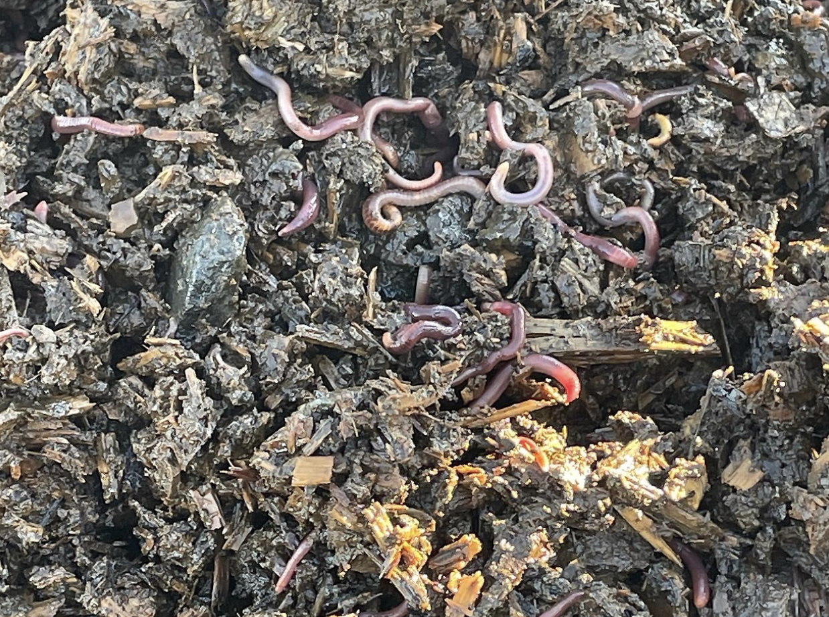
ADVANCED TREATMENT
Vermifiltration
This process incorporates earthworms which stabilize carbon and nitrogen, move air and water through the manure, and produce worm castings (a value-added product).
Miito, G., Ndegwa, P., Alege, F., Coulibaly, S. 2022. Efficacy of a vermifilter at mitigating greenhouse gases and ammonia emissions from dairy wastewater. https://doi.org/10.1002/jeq2.20367

Slide 15
COMPOSTING
Composting is the aerobic partial decomposition of manure organic matter
Emissions from composting vary by moisture content, temperature, carbon and nitrogen content, and the pH of the manure
Farms should consider the trade-offs between reducing
methane emissions vs. ammonia and nitrous oxide emissions.
United States Environmental Protection Agency [EPA] 2024. AgSTAR: Practices to Reduce Methane Emissions from Livestock Manure Management. https://www.epa.gov/agstar/practices-reduce-methane-emissions-livestock-manure-management
Leytem, A.B., S. Archibeque, N.A. Cole, S. Gunter, A. Hristov, K. Johnson, E. Kebreab, R. Kohn, W. Liao, C. Toureene, and J. Tricarico. 2024. Quantifying greenhouse gas fluxes in agriculture and forestry: Methods for entity-scale inventory. Chapter 4: Quantifying greenhouse gas sources and sinks in animal production systems. https://www.usda.gov/oce/entity-scale-ghg-methods/download
Notes:
https://dairy.photoshelter.com/search/result/I0000B46yS66f92k?terms=compost&

Slide 16
MANURE OPPORTUNITIES
Manure can produce:
Energy through anaerobic digestion
Livestock bedding
Biodegradable containers
Nutrient rich fertilizer
Lim, T., Massey, R., McCann, L., Canter, T., Omura, S., Willett, C., Roach, A., Key, N., and Dodson, L. 2023. Increasing the Value of Manure for Farmers. https://www.ers.usda.gov/publications/pub-details/?pubid=106088

Slide 17
Debunking Manure Myths

Slide 18
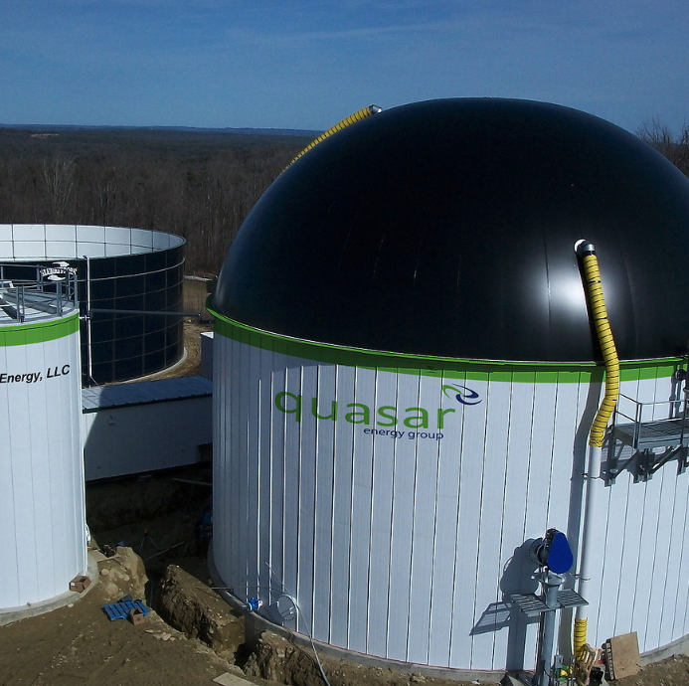
MANURE MYTH #1
One technology will enable me to achieve net zero
False! There is no one magic bullet to reduce emissions.
For example, installing a digester may help to reduce overall farm emissions but that only addresses one source of GHG on the farm, so just having a digester cannot get you to net zero GHG emissions!
Notes:
https://dairy.photoshelter.com/galleries/C0000.P4WrHK5QIU/G0000RNaekCBZybg/I0000ht1IkHM.cNM/Jordan-Farm-1-jpg

Slide 19
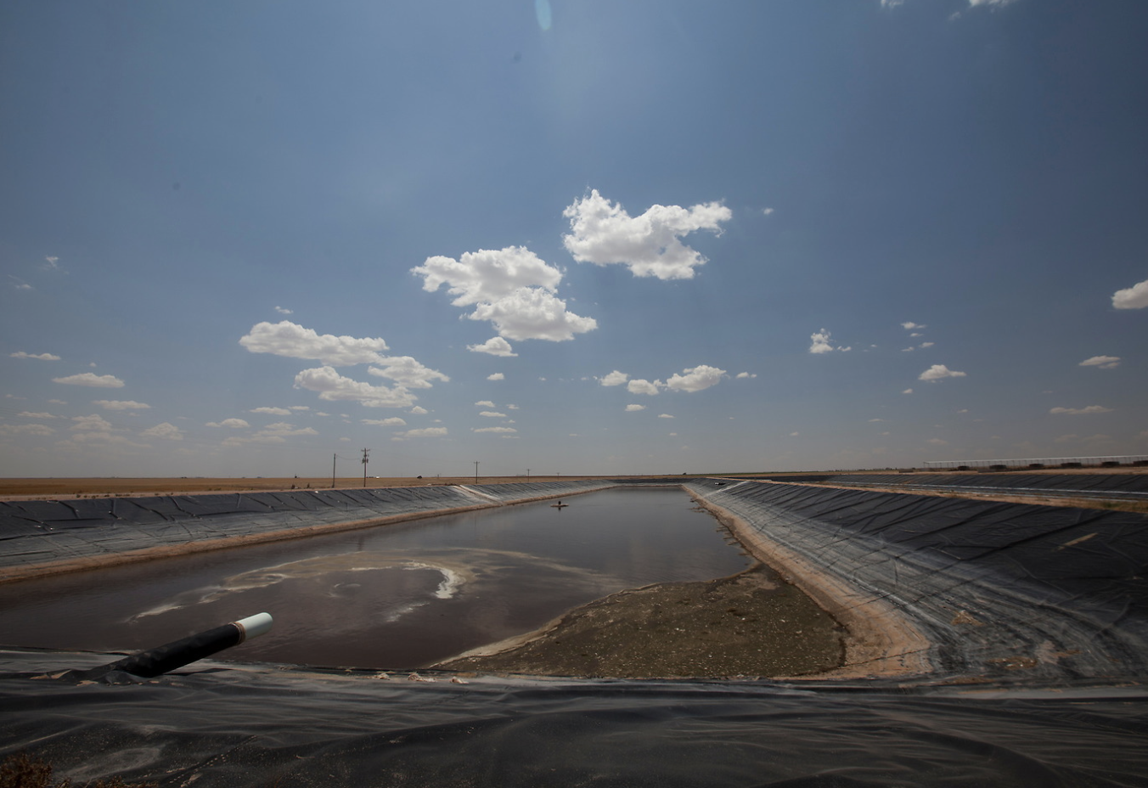
MANURE MYTH #2
A crust on liquid storage will decrease methane emissions.
Caution! In many cases, the crust does little to reduce methane emissions because it is not perfectly sealed and may not have uniform coverage. A crust can also generate other emissions like N₂O, an important trade-off to consider!
Notes:
https://dairy.photoshelter.com/galleries/C0000.P4WrHK5QIU/G0000RNaekCBZybg/I0000LJmY65exy70/MG-3031-jpg

Slide 20
MANURE MYTH #3
Manure storage additives will reduce emissions.
Don’t believe everything you hear! Companies sell all sorts of additives and we often do not know if the products are viable or not.
Notes:
https://dairy.photoshelter.com/galleries/C0000.P4WrHK5QIU/G0000RNaekCBZybg/I0000d7nSNgk46IU/HH-Pan-12-jpg

Slide 21
Conclusion

Slide 22
KEY TAKEAWAYS
1
Greenhouse gas emissions from stored manure contribute to the overall emissions footprint of dairy farms.
It is important to consider the entire manure management system and the goals of the farm when working to reduce emissions.
2
There are many available mitigation options, farms should determine the sources of manure emissions on their farms and consult experts to find the best strategies for their operations.
3

