Slide 1
Understanding Carbon Markets for the Dairy Sector

Slide 2
OBJECTIVES
Explain and illustrate the differences between Scope 1, 2, and 3 emissions.
Explain concept of carbon markets, how they work, and factors to consider when evaluating potential markets.
Highlight evolving opportunities for dairy farmers to participate in carbon markets.
Note: Opportunities for dairy farm involvement in carbon markets continue to evolve and it is important to stay informed about new trends and policies.

Slide 3
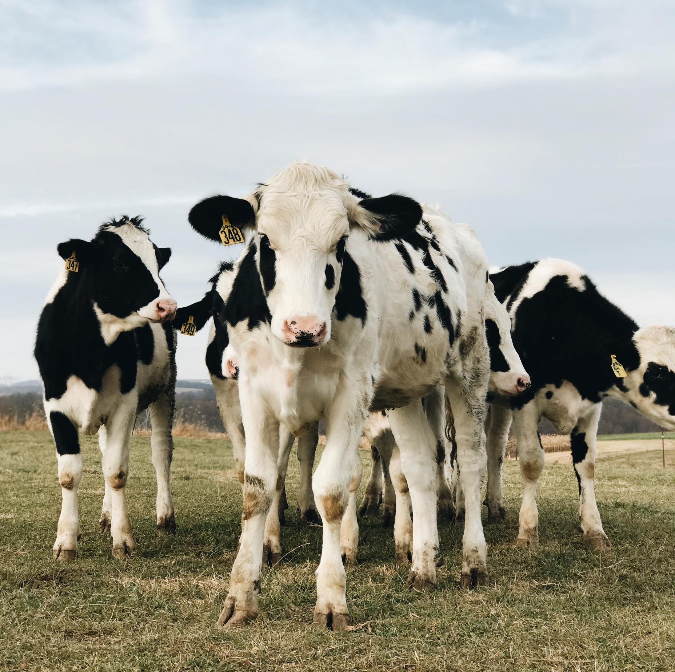
AGENDA
The Differences Between Scope 1, 2, and 3 Emissions
Understanding Carbon Markets
How to Evaluate a Carbon Market
How Dairy Farms Can Participate in Carbon Markets
Key Takeaways

Slide 4
Different Types of Emissions: Scope 1, 2, and 3

Slide 5
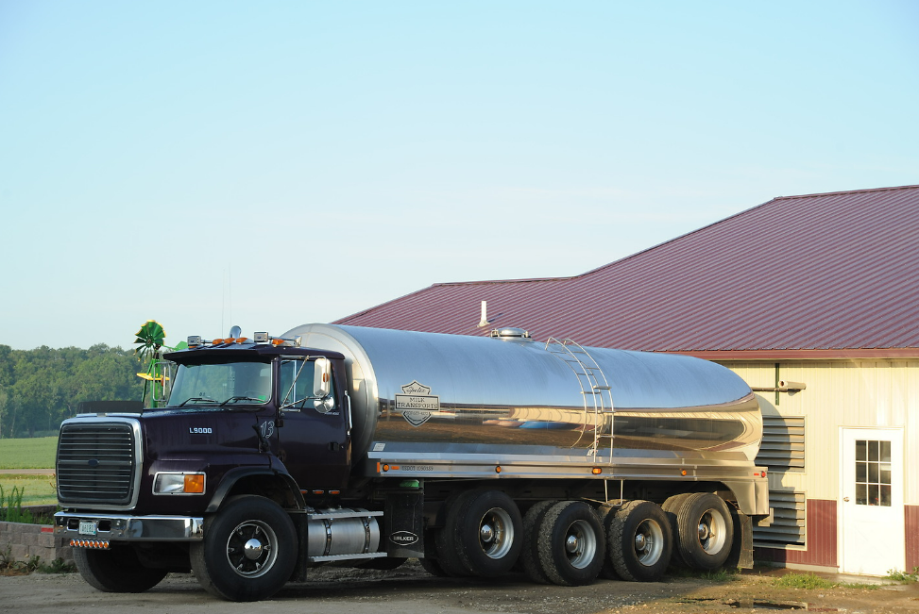
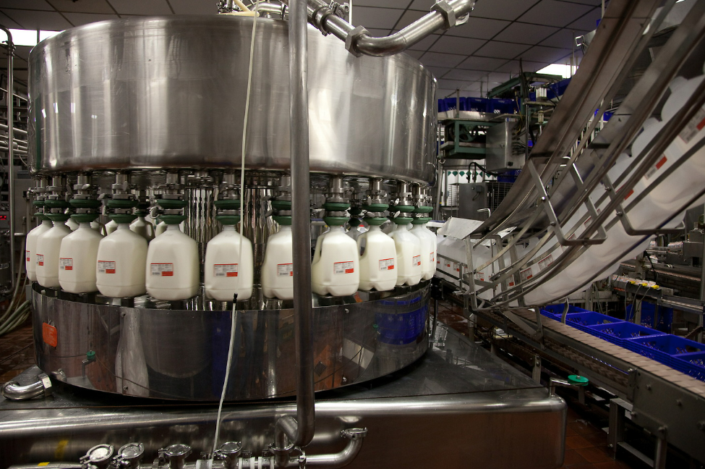
Types of Emissions
A company or organization’s emissions are divided into scopes to account for the different types of direct and indirect emissions
Scope categorization varies based on company perspective, or where they are in the value chain
Notes:
https://dairy.photoshelter.com/galleries/C0000O09TG0cSFoI/G00007NHY6.aCxeI/I0000pch0jyex_JE/18CR0208-jpg
https://dairy.photoshelter.com/galleries/C0000O09TG0cSFoI/G0000.vlA2y4vsGo/I00000q0tkEFs9mE/Anderson-13-jpg
https://dairy.photoshelter.com/galleries/C0000O09TG0cSFoI/G0000.vlA2y4vsGo/I0000VXYr7xztDR0/MDA-ImageLib-MilkTruck-atFarm-jpg

Slide 6
SCOPE 1: Emissions controlled by the company directly
SCOPE 2: Emissions that occur elsewhere but that a company has operational control over
For a milk processor, an example of scope 1 emissions includes the tailpipe emissions from fuel combusted by milk trucks during milk transport, assuming the processor owns or controls the truck fleet.
For a milk processor, an example of scope 2 emissions includes the emissions associated with producing and transmitting the energy used to light their buildings and power their machines.
Notes:
https://dairy.photoshelter.com/search/result/I0000QwG_C9DP9bg?terms=retail&
https://dairy.photoshelter.com/galleries/C0000.P4WrHK5QIU/G0000ksZ07N98BFg/I00006K2agiBdAfw/Modern-dairy-farm
https://dairy.photoshelter.com/galleries/C0000.P4WrHK5QIU/G0000MkKeTTWyFAQ/I0000B71Iuqmw9NQ/Crave20-216-jpg
https://dairy.photoshelter.com/galleries/C0000O09TG0cSFoI/G0000.vlA2y4vsGo/I0000MIRcoY0Pmw0/09-227x096DairyFacility-nef
https://dairy.photoshelter.com/galleries/C0000O09TG0cSFoI/G0000.vlA2y4vsGo/I00003Cc2vyBn1MY/115977-HRSL-F1-014-jpg

Slide 7
SCOPE 3: All other indirect emissions not covered by Scope 2, upstream or downstream in the value chain
For a milk processor, an example of scope 3 emissions includes all the on-farm emissions from the production of the raw milk such as:
Manure management and storage
Enteric fermentation from cows
Growing, fertilizing, and harvesting crops
Farm energy consumption
Notes:
https://dairy.photoshelter.com/galleries/C0000.P4WrHK5QIU/G0000VrdTvXRd9Mo/I0000UwHRMSRYJeM/Patterson-013-jpg

Slide 8
INTRODUCTION TO CARBON MARKETS
CO₂e is a unit expressing the impact of greenhouse gases in terms of the amount of CO₂ that would have the same global warming effect.
Carbon markets refer to the buying and selling of carbon credits; one credit represents 1 ton of GHG emission reduction or removal, measured in CO₂e.
Companies or organizations might buy carbon credits to compensate for their emissions.

Slide 9
INTRODUCTION TO CARBON MARKETS
Carbon markets can be created by regional, state, or national governments, co-ops, companies, or environmental NGOs
They support climate change related goals by providing a key mechanism for companies to invest in mitigating their GHG emissions
Notes:
https://dairy.photoshelter.com/search/result/I0000QwG_C9DP9bg?terms=retail&
https://dairy.photoshelter.com/galleries/C0000.P4WrHK5QIU/G0000ksZ07N98BFg/I00006K2agiBdAfw/Modern-dairy-farm
https://dairy.photoshelter.com/galleries/C0000.P4WrHK5QIU/G0000MkKeTTWyFAQ/I0000B71Iuqmw9NQ/Crave20-216-jpg
https://dairy.photoshelter.com/galleries/C0000O09TG0cSFoI/G0000.vlA2y4vsGo/I0000MIRcoY0Pmw0/09-227x096DairyFacility-nef
https://dairy.photoshelter.com/galleries/C0000O09TG0cSFoI/G0000.vlA2y4vsGo/I00003Cc2vyBn1MY/115977-HRSL-F1-014-jpg

Slide 10
THE TYPES OF CARBON MARKETS:
1) Compliance Markets
Usually “Cap-and-trade”
Support a program or regulation requiring industries to cap GHG emissions at a specific amount
Companies with emissions totals below the cap can sell their remaining allowance to other companies in “hard to abate” sectors, which may struggle to stay within the cap

Slide 11
THE TYPES OF CARBON MARKETS:
2) Voluntary Markets
Allow businesses, organizations, and individuals whose emissions are not regulated to participate
Can support environmental goals by enabling companies to offset emissions and move toward net zero
Can support industries whose emissions are difficult to mitigate or remove internally

Slide 12
Understanding Carbon Markets: Terms and Concepts

Slide 13
TERM: CARBON INSETS
Carbon Insets
Emissions reductions within a company’s value chain
An integrated approach
Example: a food company invests in a project to reduce enteric methane emissions on a farm in their supply chain and buys the associated carbon credits

Slide 14
TERM: OFFSETS
Carbon Offsets
Compensate for a company’s unavoidable emissions by funding equivalent GHG reductions or removals elsewhere
Example: a shipping company purchases carbon credits generated through a methane digester on a dairy farm to offset its scope 1 emissions

Slide 15
CONCEPT: QUALITY IN CARBON CREDITS
Quality carbon credits encompass several aspects:
Ensuring a carbon credit is equivalent to 1 ton of CO₂e through the processes of measurement, reporting, and verification
Concepts of additionality, permanence, and avoiding double counting
There is no generally accepted quality assurance or measurement scheme so assessment of quality falls to the carbon markets and buyers of carbon credits
Notes:
https://dairy.photoshelter.com/galleries/C0000.P4WrHK5QIU/G0000RNaekCBZybg/I0000bigdOR6kHPE/151008-MitchW-0241-jpg

Slide 16
CONCEPT: MEASUREMENT, MONITORING, REPORTING, VERIFICATION (MMRV)
Measurement, monitoring, reporting, and verification are essential for carbon programs and markets to ensure credibility and transparency for carbon credits.
Different carbon markets may have different requirements for how carbon credits are measured, monitored, reported, and verified.

Slide 17
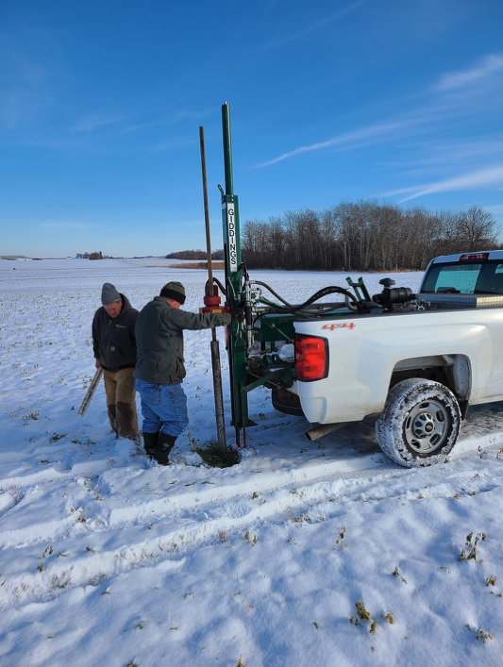
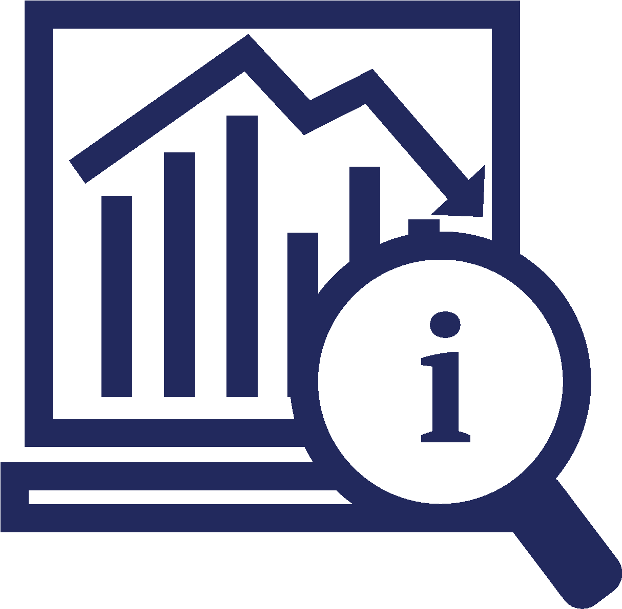
TERMS: MEASUREMENT & MONITORING
Measurement and Monitoring:
Completed directly through methods like soil testing, gas collection
Completed indirectly through technology like modeling, benchmarking, and remote sensing
Notes:
https://dairy.photoshelter.com/search/result/I0000E0t9ZjGZ30k?terms=soil&

Slide 18
TERMS: REPORTING & VERIFICATION
Reporting:
Verification:
Compiling and sharing this information in standardized formats that are aligned with accepted and recognized standards and frameworks
Making it accessible to stakeholders
Reviewers (ideally from a third-party) audit the reported measurements
Ensure reports are accurate
Confirms that proper procedures were employed

Slide 19
TERM: ADDITIONALITY
Actions being taken to generate the credit are additive to what would have been happening already
The carbon reduction or removal would not have occurred without the project
Notes:
2012-06-23_18.00.59 Digester from Jerry.jpg

Slide 20
TERM: PERMANENCE
Refers to the lasting impact of the carbon credit
Some carbon programs will specify how long producers are required to maintain their carbon reduction/storage practices
Agricultural and land-based removals typically sequester carbon for several decades, whereas geologic storage sequesters carbon for thousands of years
It is particularly important to monitor for carbon leakage in land-based dairy GHG removal projects
Notes:
https://dairy.photoshelter.com/galleries/C0000.P4WrHK5QIU/G0000RNaekCBZybg/I0000ht1IkHM.cNM/Jordan-Farm-1-jpg

Slide 21
CONCEPT: AVOIDING DOUBLE COUNTING, ISSUANCE, AND CLAIMING
Refers to the concept that one ton of GHG emissions reduced or removed is not counted, issued and/or claimed more than once
When carbon credits are transacted through carbon markets, actions should be taken to ensure that the same credit is not issued to multiple parties
The credit is only counted and claimed by the purchaser, and their supply chain, exclusively
Notes:
https://dairy.photoshelter.com/galleries/C0000.P4WrHK5QIU/G0000VrdTvXRd9Mo/I0000t8eQp5kETPQ/151008-MitchW-0248-jpg

Slide 22
Opportunities for Dairy Farmers in Carbon Markets

Slide 23
LOW CARBON FUEL STANDARD (LCFS) AND DIGESTER MARKETS
LCFS requires that the carbon intensity of transportation fuels be reduced
Digesters allow for:
Reduction in emissions on-farm through the capture of gases released from manure storage (which can be sold as carbon credits)
Creation of biofuel that can then be used as an alternative, lower carbon fuel than traditional natural gas
Notes:
https://dairy.photoshelter.com/galleries/C0000.P4WrHK5QIU/G0000RNaekCBZybg/I0000d6FI7vf86t8/Crave20-280-jpg

Slide 24
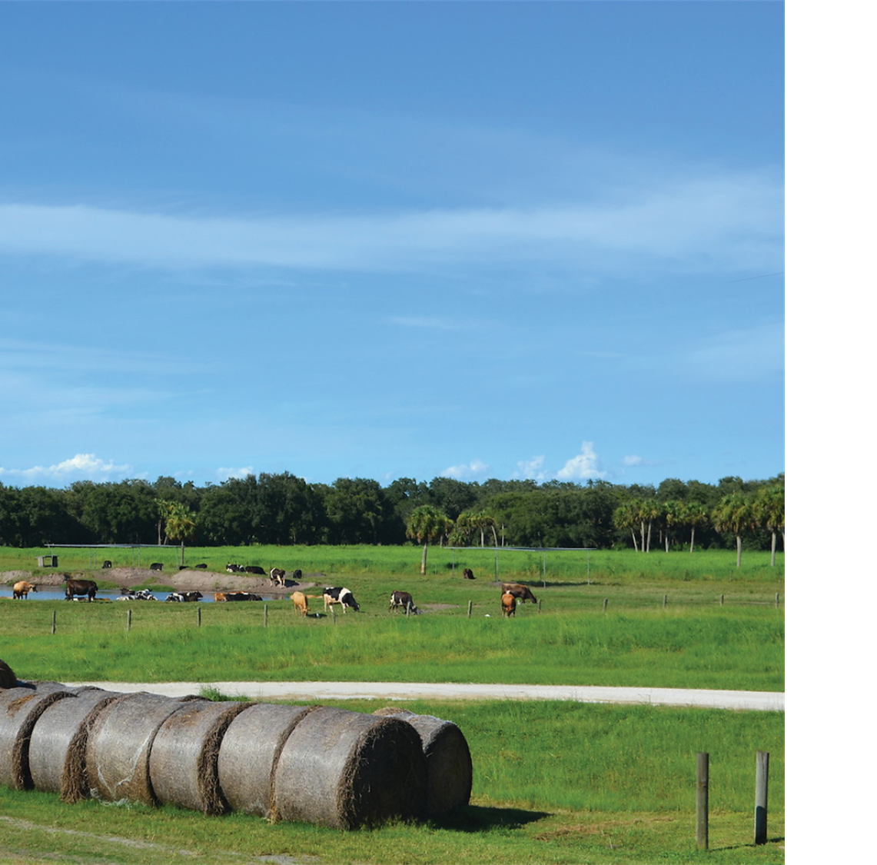
CARBON SEQUESTRATION MARKETS
Markets are still emerging, but they hold potential as an opportunity to support carbon sequestration through:
Rotational grazing
Tree planting
Improved land use practices
Notes:
Image from the catalogue: DSC_0202.JPG
FLORIDA DAIRY FARMERS

Slide 25
FEED ADDITIVE MARKETS
Emerging opportunities in reducing enteric methane emissions through feed additives
Always confirm that an additive is authorized and registered to mitigate methane emissions before feeding it for that purpose
Other markets may develop around water management and biodiversity,
with new opportunities for dairy farmers.
Notes:
https://dairy.photoshelter.com/galleries/C0000.P4WrHK5QIU/G0000L5rTqitaK7k/I00008OZaIX7BLc0/Unlimited-Usage-for-DMI-2023

Slide 26
WHERE DO WE GO FROM HERE?
There are ongoing efforts to improve technological advancements related to carbon markets (e.g., improved modeling methods) and practices for carbon reduction and sequestration
Accounting guidance continues to evolve following target setting
Policy developments and regulatory changes continue to impact carbon pricing and market participation as new compliance markets and standards come into effect
Notes:
https://dairy.photoshelter.com/galleries/C0000.P4WrHK5QIU/G0000L5rTqitaK7k/I0000r8b4284hPOI/Unlimited-Usage-for-DMI-2023

Slide 27
Conclusion

Slide 28
KEY TAKEAWAYS
Companies are interested in reducing emissions and different types of carbon markets are developing to support these efforts.
High quality carbon credits should consider a robust process of measuring, reporting, and verification, and the additionality and permanence of projects.
There are evolving opportunities for dairy farms to participate in carbon markets, but more standardization is needed to facilitate scale.

