Slide 1
A Guide to Managing Enteric Methane Emissions

Slide 2
OBJECTIVE
Introduce enteric methane and its importance as a source of greenhouse gas emissions
Discuss the role of enteric methane reduction for a sustainable dairy industry
Showcase current and future on-farm options for reducing enteric methane emissions

Slide 3
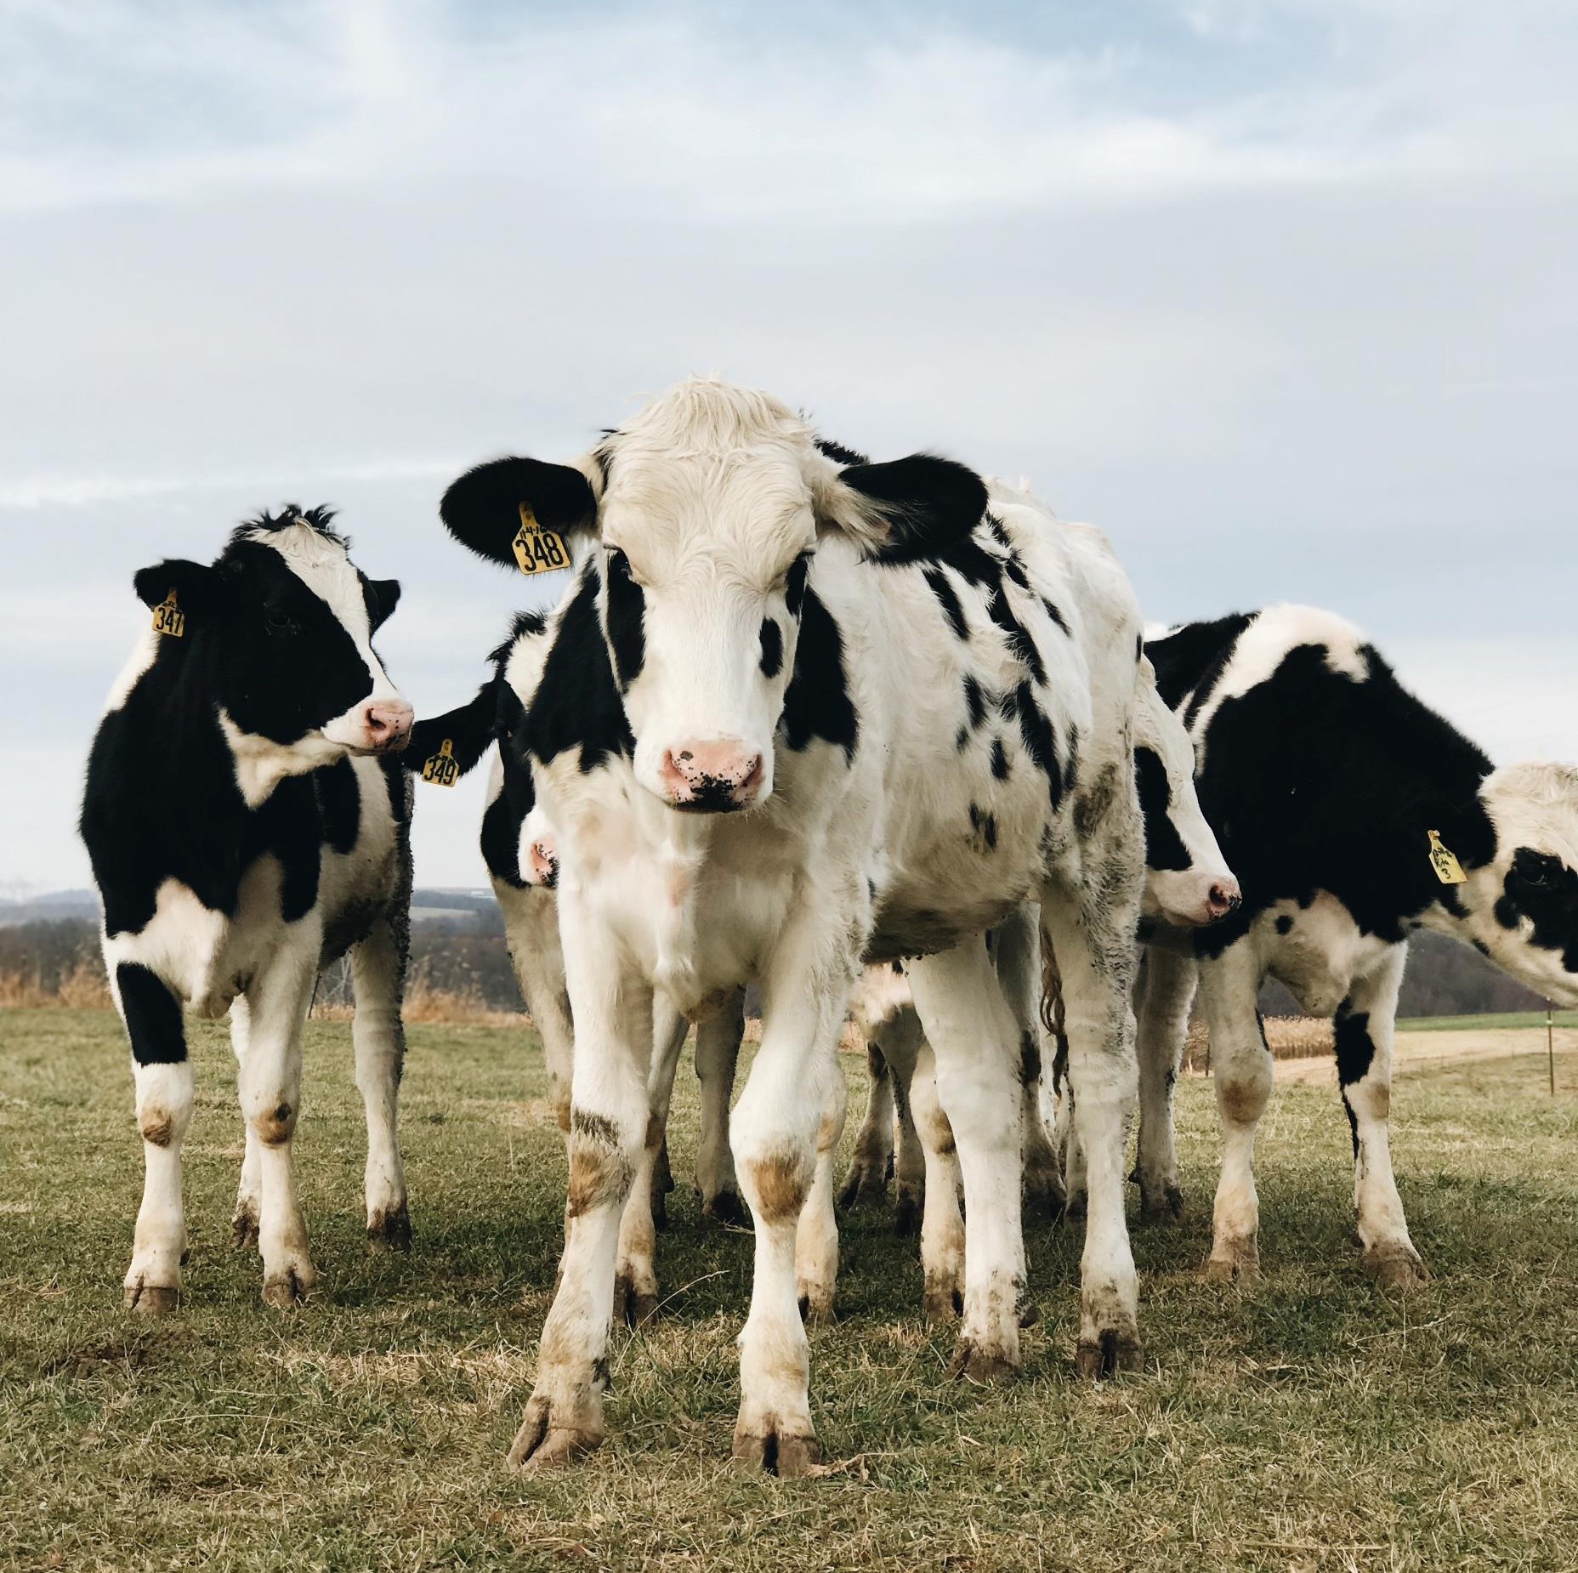
AGENDA
Methane Basics
Enteric Methane and Sustainability
Current Options for Emission Reduction
Future Options for Emission Reduction
Key Takeaways

Slide 4
Methane Basics

Slide 5
What is methane?
Methane is a type of greenhouse gas (GHG)
GHGs trap heat from the sun, just like a greenhouse does
Warmer global temperatures and volatile weather patterns affect us all
GHGs

Slide 6
What is enteric methane?
Enteric methane is methane produced by ruminants
Ruminants rely on microbial fermentation to digest food
A by-product of this fermentation process is methane

Slide 7
Enteric Methane and Sustainability

Slide 8
Why does enteric methane matter?
Accumulation of GHGs, including methane, impacts us all
Reducing emissions contributes to sustainability of the dairy industry
Being good stewards of the environment strengthens reputation of farmers

Slide 9
How does enteric methane compare?
Overall US Agricultural Emissions Comparison
United States Environmental Protection Agency. 2024. Draft Inventory of U.S. Greenhouse Gas Emissions and Sinks: 1990-2022. https://www.epa.gov/ghgemissions/draft-inventory-us-greenhouse-gas-emissions-and-sinks-1990-2022.

Slide 10
How does enteric methane compare?
PERCENTAGES OF ON-FARM EMISSIONS
As an industry, we need to find areas to improve across all of these sources.
As one of the highest sources of emissions, enteric methane is a primary area we can focus on.
Thoma et al. 2013. Greenhouse gas emissions from milk production and consumption in the United States: A cradle-to-grave life cycle assessment circa 2008. International Dairy Journal. https://doi.org/10.1016/j.idairyj.2012.09.010.

Slide 11
Current Options for Emission Reduction

Slide 12
Measuring Emission Reductions
Emissions Intensity
GHG emissions per unit of milk (for example, grams per liter or pounds per gallon)
Absolute Emissions
Total GHG emissions over a period of time (for example, grams per day)
These measures are different ways to think about how a farm’s actions and choices impact their GHG emissions

Slide 13
Animal Management
LOWERING ENTERIC EMISSIONS BY IMPROVING ANIMAL HEALTH
Healthy Cows
Improving cow comfort
Improving reproductive efficiency
Reducing disease
Productive Cows
Reduced enteric methane emissions intensity
Reduced costs of disease treatment
For example, for every 1% decrease in clinical mastitis prevalence, GHG emissions per unit of milk decrease by 2% and total herd GHG emissions decrease by 1%.

Slide 14
NUTRITION
REDUCING ENTERIC METHANE THROUGH DIET
Feeding rumen available fats and more starch
Reduces amount of hydrogen available for methane production
Highly digestible ingredients
Highly digestible forage fiber
Grain processing
Reduces emissions intensity
High productivity diets
Provision of nutrients to support high milk production
Reduces emissions intensity
Diet changes should be balanced by a professional dairy cow nutritionist to maintain a healthy rumen

Slide 15
CURRENT OPTIONS SUMMARY
Maintaining healthy & comfortable cows reduces:
Emissions intensity
Costs associated with disease
Diet formulations can reduce absolute emissions and emissions intensity
Notes:
Photo: https://dairy.photoshelter.com/galleries/C0000.P4WrHK5QIU/G0000Kid38pHom.I/I0000IGEslz2EC6o/Clauss-18CR0430-jpg

Slide 16
Future Options for Emission Reduction

Slide 17
FEED ADDITIVES
INGREDIENTS THAT REDUCE METHANE PRODUCTION
Added to the diet in small quantities
Take effect quickly
Additives are intended to reduce the production of methane in the rumen, not to provide nutrition
Always confirm an additive is authorized and registered for mitigating methane emissions before feeding it for that purpose

Slide 18
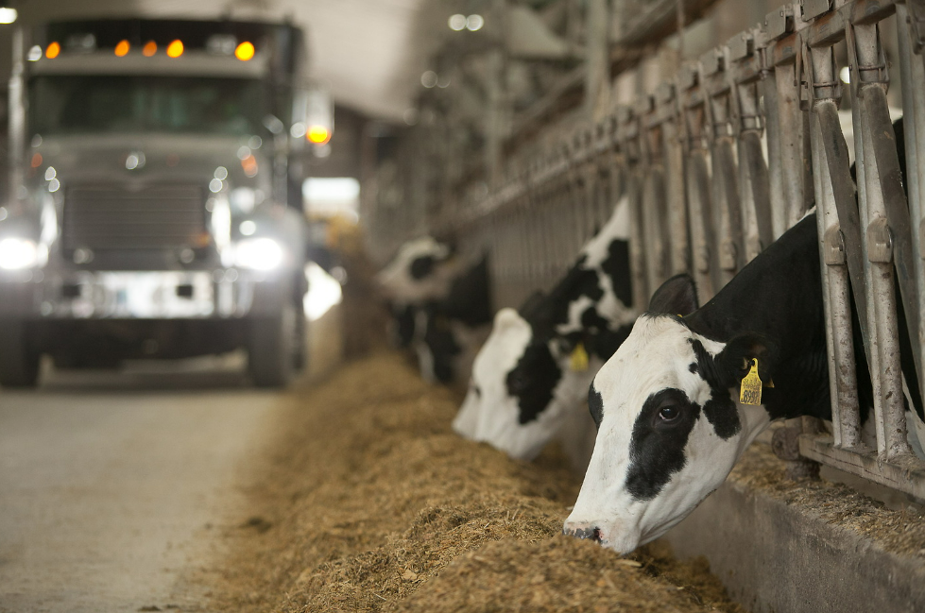
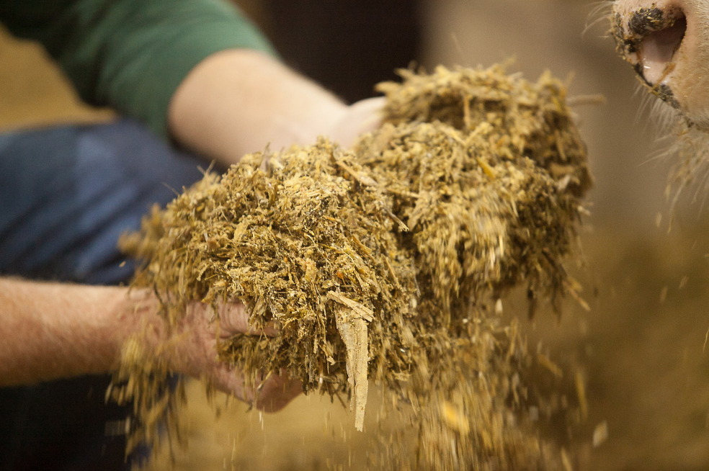
METHANE INHIBITORS
Current as of June 2024
INGREDIENTS THAT IMPEDE METHANE PRODUCERS
3-Nitroxypropanol (3-NOP/Bovaer®)
Can reduce enteric methane by 30%
Approved for use in the U.S.
Red Algae Seaweed (Halogens/Brominata®)
Can reduce enteric methane by 50%
Not approved for use in the U.S.
Nitrate
Can reduce enteric methane by 15%
Not approved for use in the U.S.
Notes:
Image: https://dairy.photoshelter.com/galleries/C0000.P4WrHK5QIU/G0000ksZ07N98BFg/I0000b6iIv0XxtRc/Crave20-219-jpg
https://dairy.photoshelter.com/galleries/C0000.P4WrHK5QIU/G0000ksZ07N98BFg/I00002CPqILRFeF0/Crave20-210-jpg

Slide 19
METHANE MODIFIERS
Current as of June 2024
If a feed additive is made up of “Generally Recognized as Safe” (GRAS) ingredients, under conditions of their intended use, FDA approval is not necessary.
INGREDIENTS THAT MAY REDUCE METHANE PRODUCED
Tannins
Tannins are polymerized polyphenolic compounds that combine with proteins to form leather-like, indigestible substances
Tannins and tannin extracts inhibit fiber digestion and can reduce rumen hydrogen and methane production
Essential oils
Volatile oils that give plants and spices their specific odors and colors
Negatively effect cell membranes of gram-positive bacteria and protozoa which produce hydrogen
Agolin Ruminant® is a combination of highly concentrated extracts of coriander, clove, and geranium. Mootral® is garlic and citrus-extract based.
Scientific evidence on enteric methane mitigation for these options is inconclusive so more evidence is needed.

Slide 20
GENETICS
Breeding for lower methane production
Long-term option
Permanent improvement
Research is ongoing into genomic indicators
This is a promising option that’s still in the development stage
The timeline for this opportunity depends on marketplace demand and research!
Notes:
Photo: https://dairy.photoshelter.com/galleries/C0000.P4WrHK5QIU/G0000hZF_UI8OdXs/I0000qTymR.6meQ0/5D3-4971-jpg

Slide 21
FUTURE OPTIONS SUMMARY
Research efforts are looking at both fast-acting and long-term options for reducing enteric methane emissions
Development and adoption of future options will depend on research, regulatory approval, and consumer demand

Slide 22
Conclusion

Slide 23
KEY TAKEAWAYS
Cows naturally produce methane as they digest food
Enteric methane is one of the largest sources of GHG emissions in the dairy sector
Some options are currently available, and more will be available in the future, to reduce methane emissions

